Slide 1

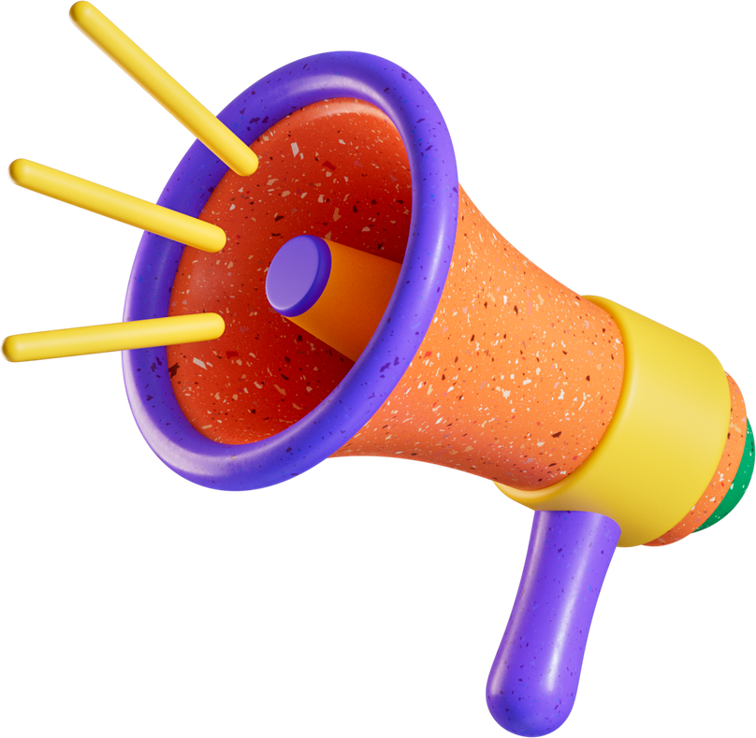



Welcome
TEAM HORIZON

Slide 2







Our
Team
Project Overview
We are creating a System that can predict upcoming climate disaster using Machine Learning model and provide a communication network ranging from 12 to 120km
G.M Sifat Iqbal
Mamunur Rashid
Sakib Ahmed
Thauhid Hussain Chowdhury
Shown Sejuti Shoily
COORDINATOR
& ELECTRICAL ENGINEER
SOFTWARE DEVELOPER
AI ENGINEER,
SOFTWARE AND BACKEND DEVELOPER, HARDWARE PROGRAMMER
LEGAL ADVISOR
UI DESIGNER

Slide 3



LIGHTNING
1
2
3
4
Average number of lightning strikes worldwide per day - 8.6 Million.
One death occurred for every 345,000 flashes.
Almost 1.5 Billion of world wealth damage world-wide.
Global annual lightning fatalities range from 6,000 to 24,000 persons per year*

Slide 4
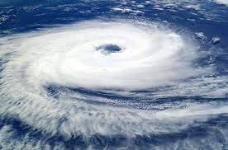
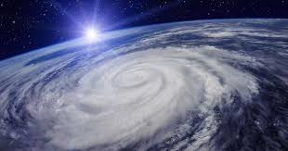
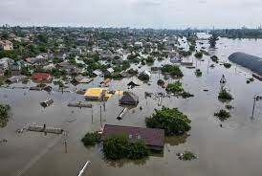
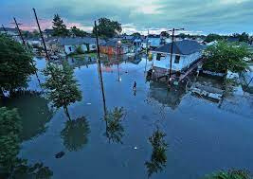

Cyclone & Flood
Cyclone
Cyclone
Flood
Flood
The annual cyclone fatalities range from 10,000 to 40,000 individuals per year. These fatalities occur due to storm surges, flooding, wind damage, and landslides.
Cyclones cause estimated total of almost 28 billion dollars in damage to world wealth annually
The annual flood fatalities range from 20,000 to 80,000 individuals per year
Floods with an estimated total of almost 40 billion dollars in damage to world wealth annually.

Slide 5

Those three are the main cause of injuries and deaths from natural disasters.
So our main goal is to create a system to find solutions for the problem mentioned above
Communication
Shelter
Alert/Caution
Lots of time communication infrastructure go
down.So it is hard to communicate on emergency situation
Zero Knowledge about nearby safe houses or shelter
Not to get proper alert about upcoming disaster

Slide 6


Sustainable
Disaster
Response
Alert
Mechanism
SDRAM
SOFTWARE
HARDWARE

Slide 7



TEAM HORIZON
Nasa’s EONET API
NASA EOSDIS grants access to EONET API for info on natural events (cyclones, floods, earthquakes, etc.).
API we are using on our App
Google FloodHub
Flood Hub is part of Crisis Response work to provide people access to trusted information and resources in critical moments — also including wildfires and earthquakes.
Tomorrow.io
Tomorrow.io is an American weather technology company. It provides real-time weather forecasting services and APIs

Slide 8
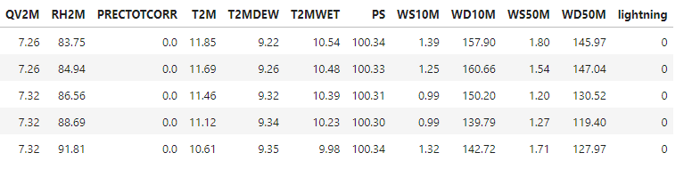
Server Running Machine Learning Model To Predict Lightning
wind speed
relative humidity
The problem is converted into binary classification by setting a threshold of 50
0 for not lightning
1 for lightning
Using SVM Classification model in order to make predictions based on those features (atmospheric conditions )
The model may generate an Alert 3 hours before a lightning strike.
The application is able to generate alerts for Flood & Cyclone Directly from API
Lightning Using Machine Learning Model
You can see the heading of the dataset below
Machine Learning Model
Alert !
Precipitation
Temperature
Wind
direction
The Power of Visual Charts

Slide 9
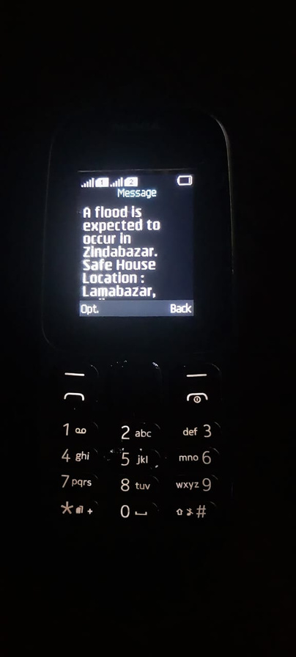

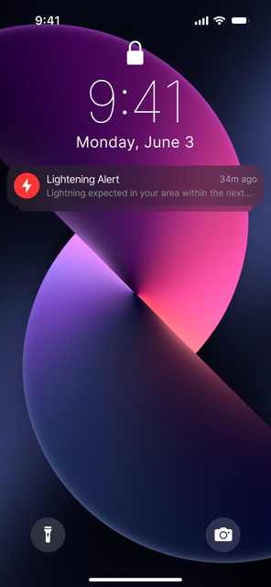
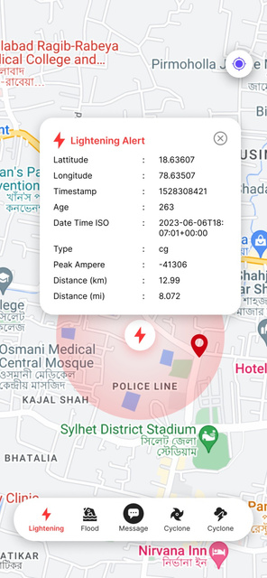
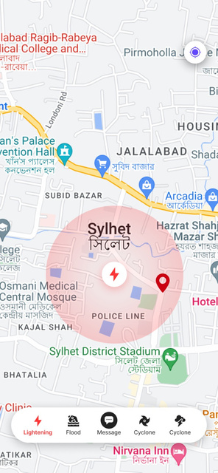


A flood is expected to occur in Zindabazar,Sylhet; Safe House Location : Lamabazar,Sylhet; For help: 01850918215 (Quick Responce Team);
Our App UI
and Functionality
Realtime Location of Safehouse and Lightning Shelter
Send push notifications and sms as alert
Prediction of Cyclone,Lightning & Flood

Slide 10


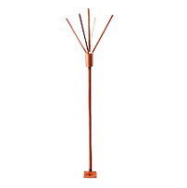
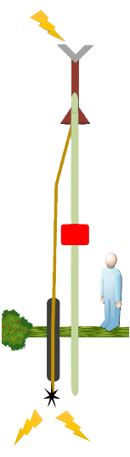

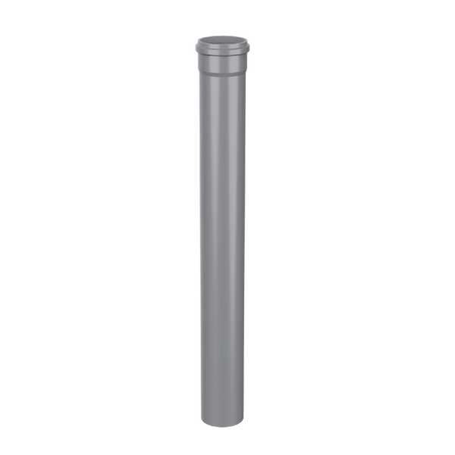
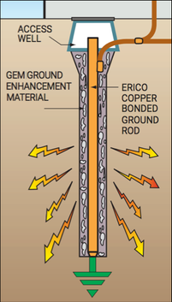
1
Mounting mechanism
2
Lightning arrester.
16 mm x 1000 mm length, 4 figure spike, with copper base plate
Dry bamboo / Hight gainer
3
5
Primary Conductor Wire.
8 m.m Smooth Wave Copper Conductor.
7
Hardware Container
4
Ground insulator.
2 meters PVC pipe.
6
Grounding Anchor
Lightning arrester used to direct the electrical energy from a lightning strike safely into the ground

Slide 11
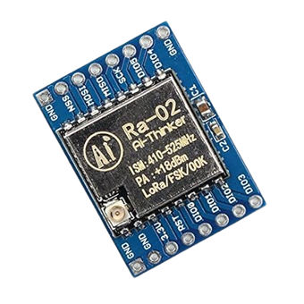
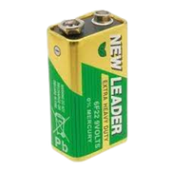
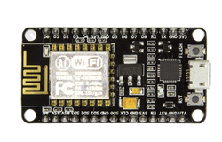
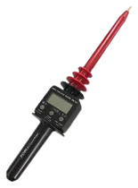
Lora Sx1278 at 433MHz used as Communication module
Node Mcu act as a core or logical unit here
9v Bettery used as power source
10 METER
High voltage transducer meter used to measuring high DC and AC voltages on Lightning
Provide REAL-TIME GPS location of lightning shelter.
A high-voltage transducer meter is employed to measure elevated DC and AC voltages during lightning events, with the intention of incorporating its data into an API for future use

Slide 12
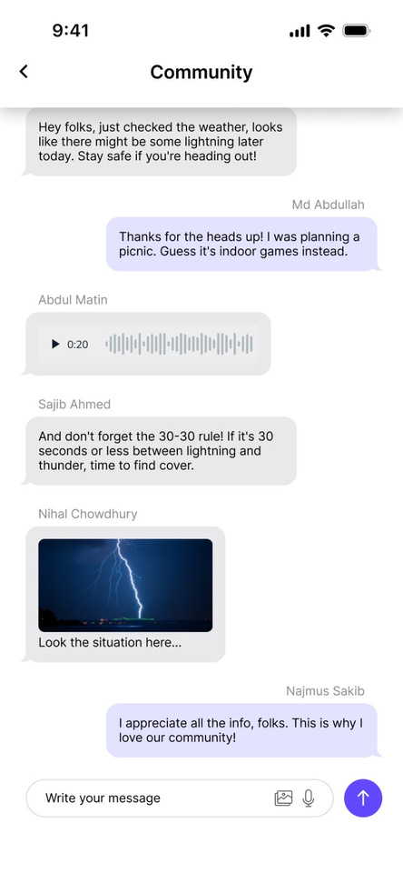

Response Mechanism
Independent and reliable communication during disasters, ensuring critical information exchange when conventional systems fail.
Lora Sx1278 at 433MHz used as Communication module

Slide 13


System Flow of Hardware
Step 1
Step 2
Step 3
Step 4
Step 5
Software and other hardware are connected to
Node Mcu
Connected to node mcu as Communication module
Connected to Node Mcu in order to make communication with the lora
Connected to software and nodemcu can make any command through software to the server. Server Used to send sms about prediction of upcoming event to keypad phone user.Also to store log info of nodemcu and user information
A High voltage transducer meter Sensor unit connected to Nodemcu for calculating lightning current

Slide 14
System flow of Mobile Application
Step 1
Step 2
Step 3
Step 4
Alert system
Send alert through sms (Button phone) and push notification (Smartphone)
Portable lightning protector
Instant lightening shelter and temporary safe house whose location will be marked in app
Data collection Module
Stored on server: LPS locations with user ID, recorded lightning data from high voltage transducer meter. Access via API.
Response Module
Constructing a Mesh topology for offline Communication with lora

Slide 15
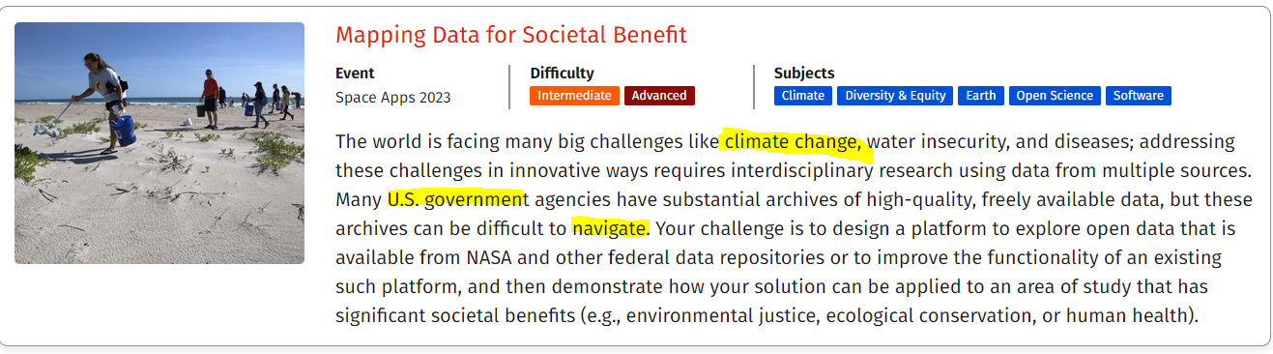

Thanks for being with us

